Slide 1
Accessibility Measures
Yunguo Cai
11/13/2017

Slide 2
Model Description
2
1000 people, 100 zones, 800 jobs
Quality: Set as a constant 1 for walking, 2 for bus and 3 for driving
HH(Household Position):
Mode 1: random to get (x,y) position in the whole region
Mode 2: group skill level together
Work status: random assign work status to each person
Job Density:
Small city: concentrated in the outer boundary of the city with skill level grouping together
Large city: concentrated in the center of the city with skill level grouped together.

Slide 3
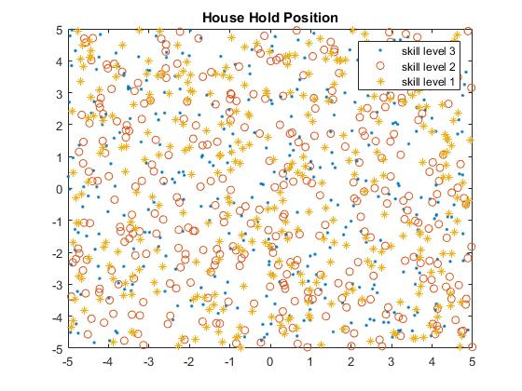
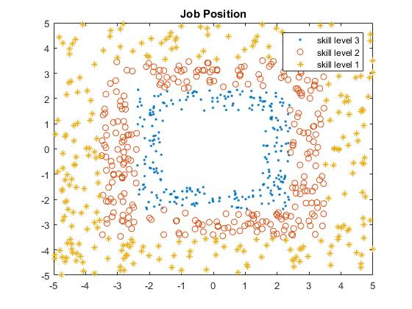
Model Description – Small City Mode 1
3

Slide 4
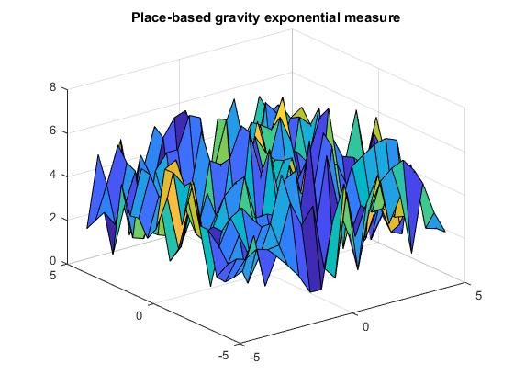

Place-based Access: Gravity type
4
Exponential model:
$$A_{i}=\sum_{j}{W_{j}e^{−βd_{ij}}}$$
where $β=0.12$.
Bhat, M., Handy, S., Kockelman, K., and Mahmassani, H. “Assessment of Accessibility Measure.” Center for transportation research.
University of Texas at Austin.

Slide 5
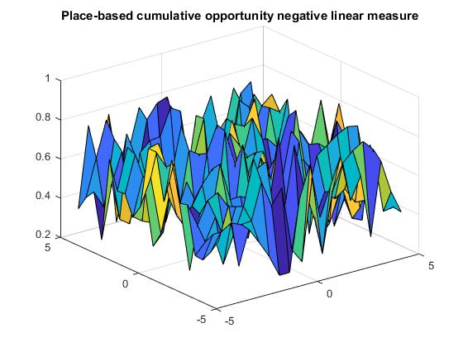
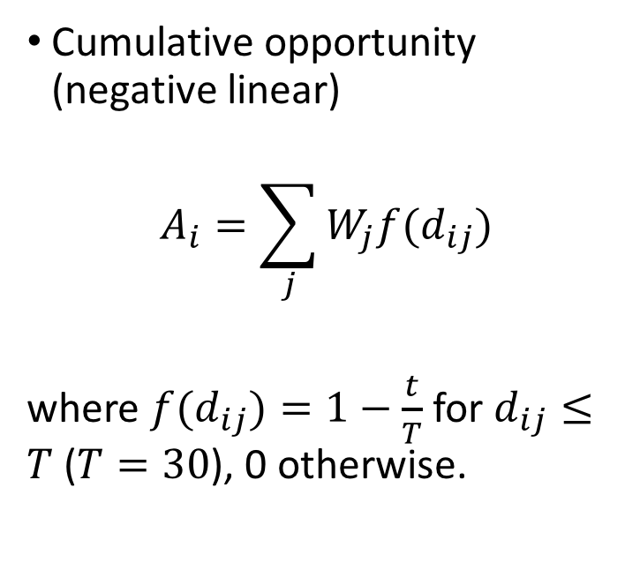
Place-based Access: Cumulative Opportunity
5
Cumulative opportunity (negative linear)
$$A_{i}=\sum_{j}{W_{j}f(d_{ij})}$$
where ${f(d}_{ij})=1−\frac{t}{T}$ for $d_{ij}≤T$ ($T=30$), 0 otherwise.
Bhat, M., Handy, S., Kockelman, K., and Mahmassani, H. “Assessment of Accessibility Measure.” Center for transportation research.
University of Texas at Austin.

Slide 6
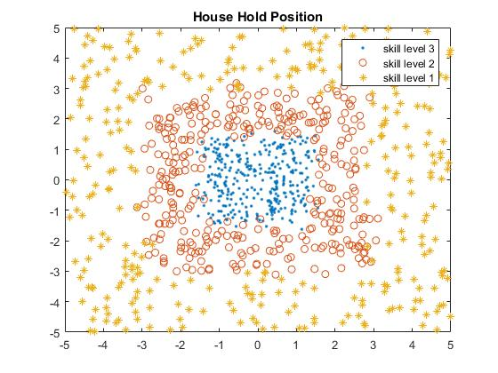
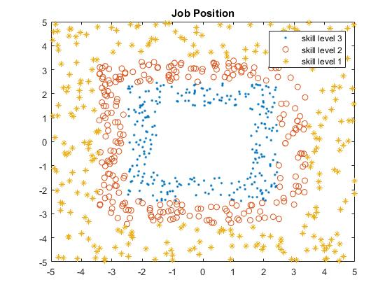
Model Description – Small City Mode 2
6

Slide 7
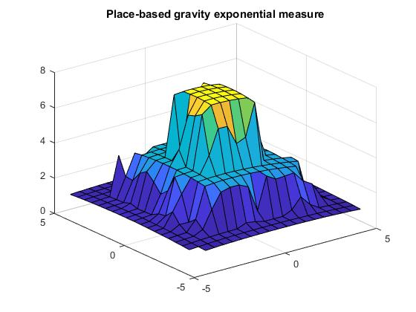
Place-based Access: Gravity type
7
Exponential model:
$$A_{i}=\sum_{j}{W_{j}e^{−βd_{ij}}}$$
where $β=0.12$.
Bhat, M., Handy, S., Kockelman, K., and Mahmassani, H. “Assessment of Accessibility Measure.” Center for transportation research.
University of Texas at Austin.

Slide 8
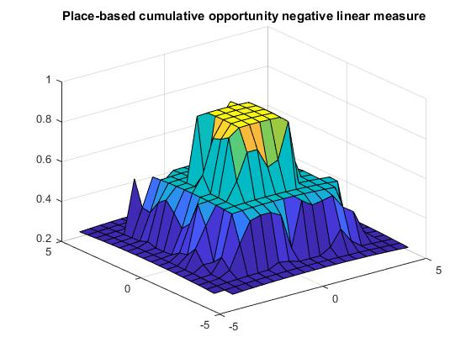
Place-based Access: Cumulative Opportunity
8
Cumulative opportunity (negative linear)
$$A_{i}=\sum_{j}{W_{j}f(d_{ij})}$$
where ${f(d}_{ij})=1−\frac{t}{T}$ for $d_{ij}≤T$ ($T=30$), 0 otherwise.
Bhat, M., Handy, S., Kockelman, K., and Mahmassani, H. “Assessment of Accessibility Measure.” Center for transportation research.
University of Texas at Austin.

Slide 9
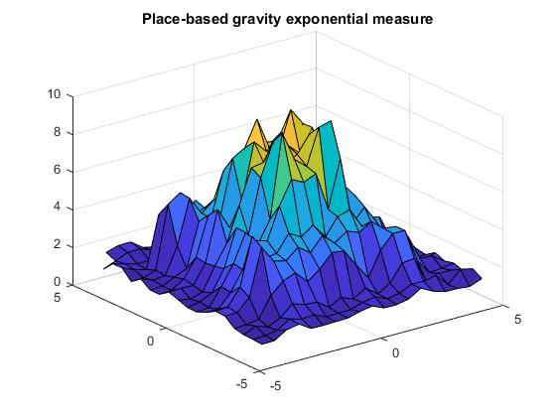
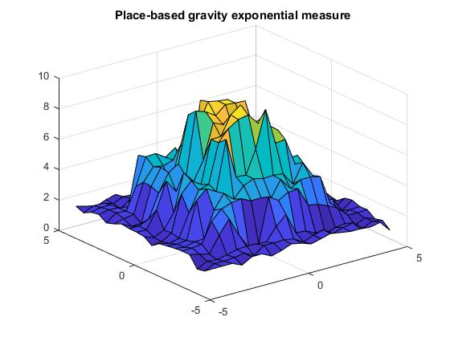
Gravity exponential model – transportation
9
No public transportation
With public transportation

Slide 10
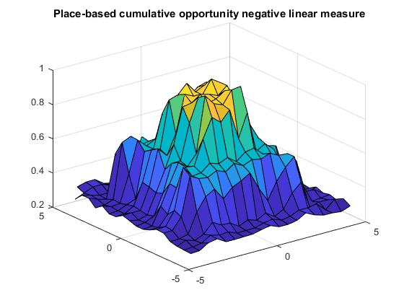
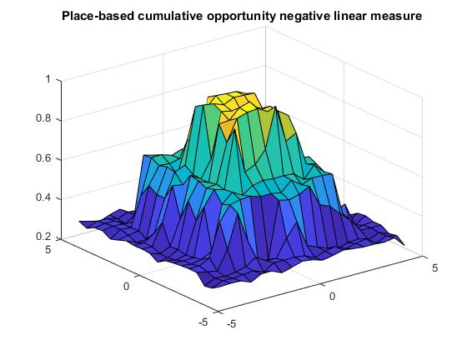
Cumulative opportunity model – transportation
10
No public transportation
With public transportation

Slide 11
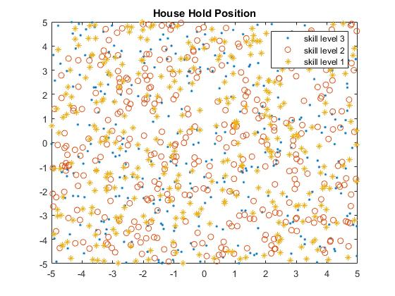
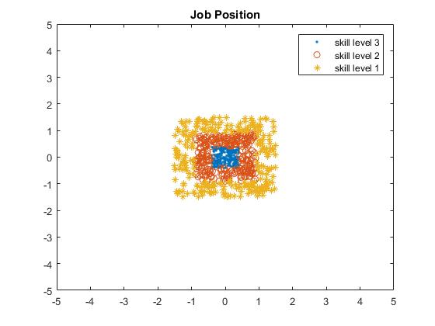
Model Description – Large City Mode 1
11

Slide 12
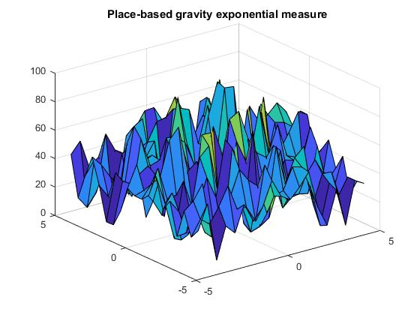
Place-based Access: Gravity type
12
Exponential model:
$$A_{i}=\sum_{j}{W_{j}e^{−βd_{ij}}}$$
where $β=0.12$.
Bhat, M., Handy, S., Kockelman, K., and Mahmassani, H. “Assessment of Accessibility Measure.” Center for transportation research.
University of Texas at Austin.

Slide 13
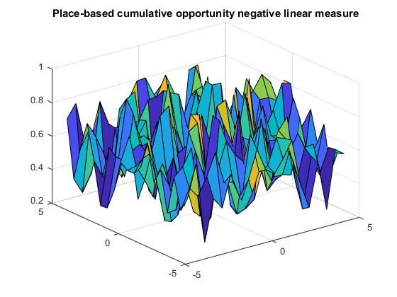
Place-based Access: Cumulative Opportunity
13
Cumulative opportunity (negative linear)
$$A_{i}=\sum_{j}{W_{j}f(d_{ij})}$$
where ${f(d}_{ij})=1−\frac{t}{T}$ for $d_{ij}≤T$ ($T=30$), 0 otherwise.
Bhat, M., Handy, S., Kockelman, K., and Mahmassani, H. “Assessment of Accessibility Measure.” Center for transportation research.
University of Texas at Austin.

Slide 14
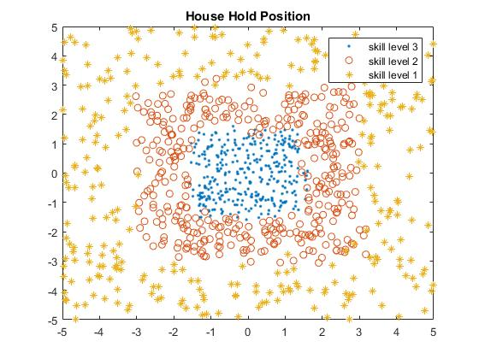
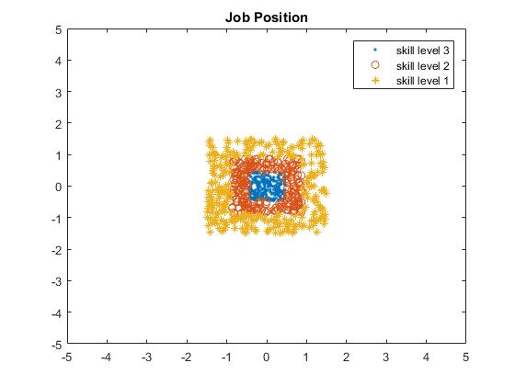
Model Description – Large City Mode 2
14

Slide 15
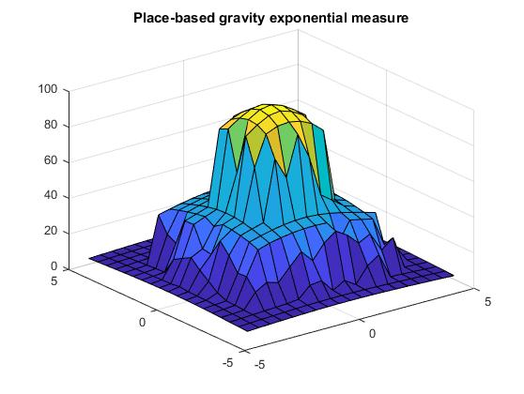
Place-based Access: Gravity type
15
Exponential model:
$$A_{i}=\sum_{j}{W_{j}e^{−βd_{ij}}}$$
where $β=0.12$.
Bhat, M., Handy, S., Kockelman, K., and Mahmassani, H. “Assessment of Accessibility Measure.” Center for transportation research.
University of Texas at Austin.

Slide 16
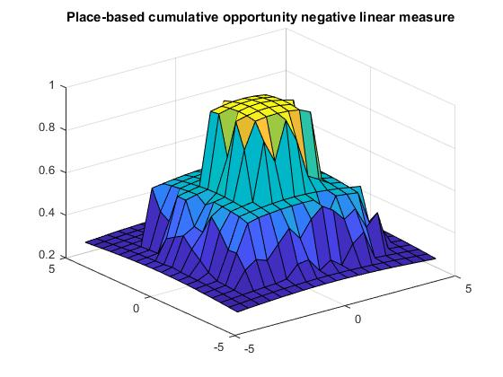
Place-based Access: Cumulative Opportunity
16
Cumulative opportunity (negative linear)
$$A_{i}=\sum_{j}{W_{j}f(d_{ij})}$$
where ${f(d}_{ij})=1−\frac{t}{T}$ for $d_{ij}≤T$ ($T=30$), 0 otherwise.
Bhat, M., Handy, S., Kockelman, K., and Mahmassani, H. “Assessment of Accessibility Measure.” Center for transportation research.
University of Texas at Austin.

Slide 17
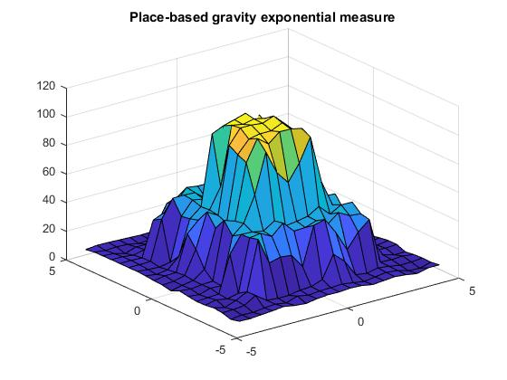
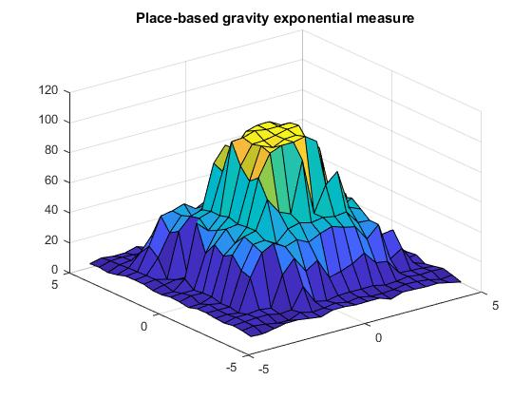
Gravity exponential model – transportation
17
No public transportation
With public transportation

Slide 18
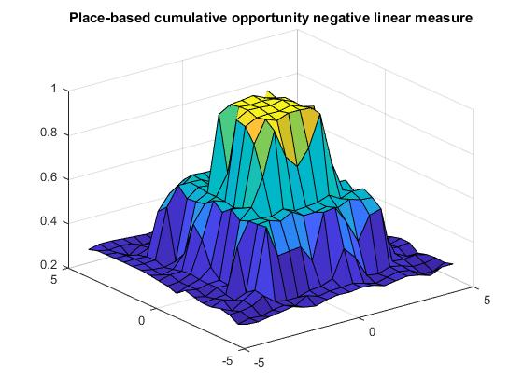
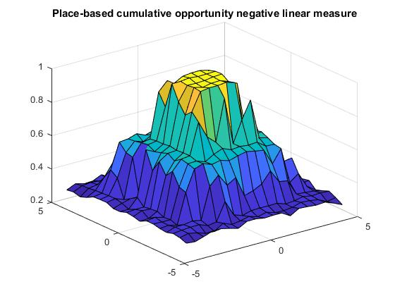
Cumulative opportunity model – transportation
18
No public transportation
With public transportation

